Slide 1
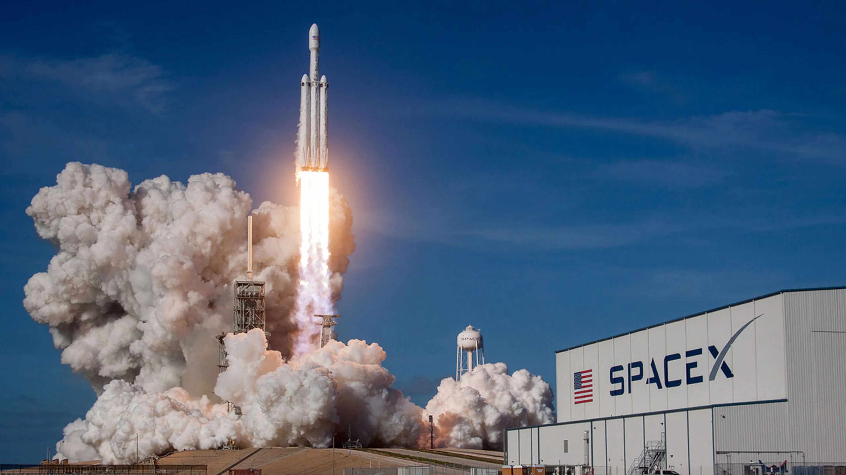
Applied Data Science capstone
Esteban Arancibia
June 14, 2025

Slide 2

OUTLINE
Executive Summary
Introduction
Methodology
Results
Discussion
Conclusion

Slide 3
EXECUTIVE SUMMARY
In this capstone project, we will predict if the SpaceX Falcon 9 first stage will land successfully using several machine learning classification algorithms.
The main steps in this project include:
Data collection, wrangling, and formatting
Exploratory data analysis
Interactive data visualization
Machine learning prediction
Our graphs show that some features of the rocket launches have a correlation with the outcome of the launches, i.e., success or failure.
It is also concluded that decision tree may be the best machine learning algorithm to predict if the Falcon 9 first stage will land successfully.

Slide 4
Outline
INTRODUCTION
In this capstone, we will predict if the Falcon 9 first stage will land successfully. SpaceX advertises Falcon 9 rocket launches on its website with a cost of 62 million dollars; other providers cost upward of 165 million dollars each, much of the savings is because SpaceX can reuse the first stage. Therefore if we can determine if the first stage will land, we can determine the cost of a launch. This information can be used if an alternate company wants to bid against SpaceX for a rocket launch.
Most unsuccessful landings are planned. Sometimes, SpaceX will perform a controlled landing in the ocean.
The main question that we are trying to answer is, for a given set of features about a Falcon 9 rocket launch which include its payload mass, orbit type, launch site, and so on, will the first stage of the rocket land successfully?

Slide 5
Outline
METHODOLOGY
The overall methodology includes:
Data collection, wrangling, and formatting, using:
SpaceX API
Web scraping
Exploratory data analysis (EDA), using:
Pandas and NumPy
SQL
Data visualization, using:
Matplotlib and Seaborn
Folium
Dash
Machine learning prediction, using
Logistic regression
Support vector machine (SVM)
Decision tree
K-nearest neighbors (KNN)

Slide 6
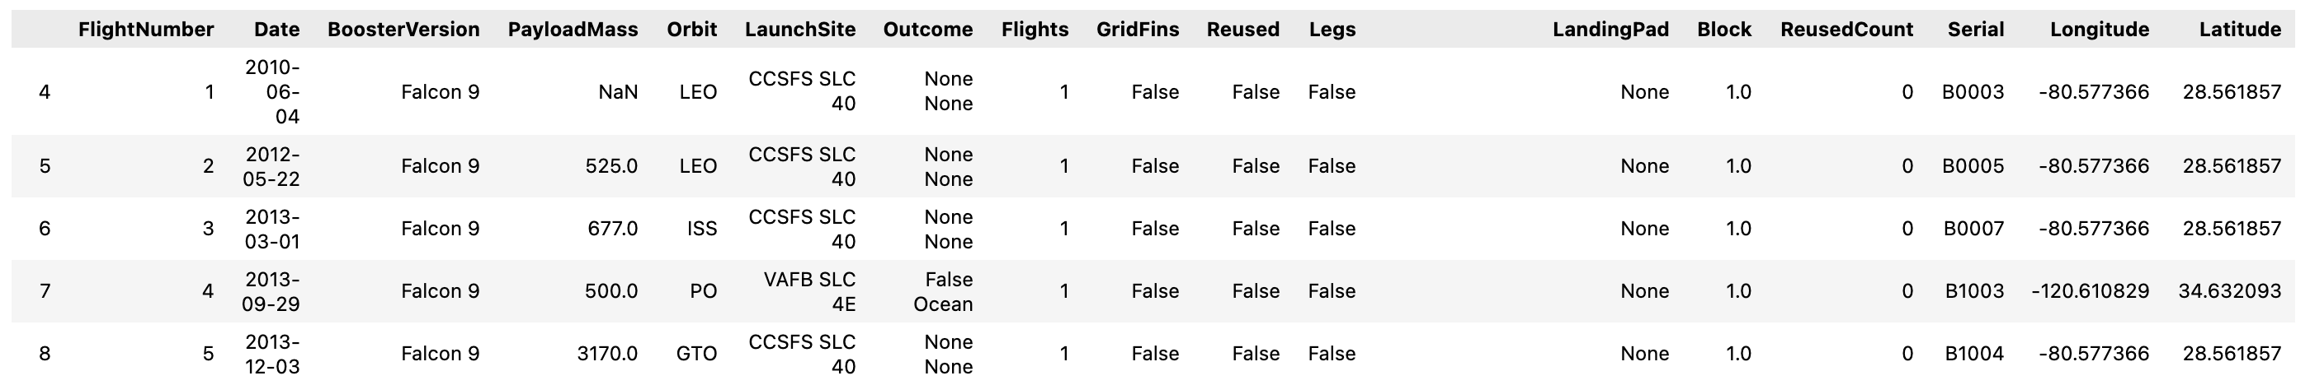
METHODOLOGY
Data collection, wrangling, and formatting
SpaceX API
The API used is https://api.spacexdata.com/v4/rockets/.
The API provides data about many types of rocket launches done by SpaceX, the data is therefore filtered to include only Falcon 9 launches.
Every missing value in the data is replaced the mean the column that the missing value belongs to.
We end up with 90 rows or instances and 17 columns or features. The picture below shows the first few rows of the data:

Slide 7
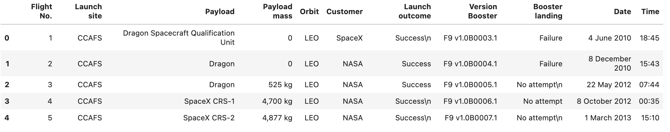
Outline
METHODOLOGY
Data collection, wrangling, and formatting
Web scraping
The data is scraped from https://en.wikipedia.org/w/index.php?title=List_of_Falcon_9_and_Falcon_Heavy_launches&oldid=1027686922
The website contains only the data about Falcon 9 launches.
We end up with 121 rows or instances and 11 columns or features. The picture below shows the first few rows of the data:

Slide 8
Outline
METHODOLOGY
Data collection, wrangling, and formatting
The data is later processed so that there are no missing entries and categorical features are encoded using one-hot encoding.
An extra column called ‘Class’ is also added to the data frame. The column ‘Class’ contains 0 if a given launch is failed and 1 if it is successful.
In the end, we end up with 90 rows or instances and 83 columns or features.

Slide 9



METHODOLOGY
Exploratory Data Analysis (EDA)
Pandas and NumPy
Functions from the Pandas and NumPy libraries are used to derive basic information about the data collected, which includes:
The number of launches on each launch site
The number of occurrence of each orbit
The number and occurrence of each mission outcome
SQL
The data is queried using SQL to answer several questions about the data such as:
The names of the unique launch sites in the space mission
The total payload mass carried by boosters launched by NASA (CRS)
The average payload mass carried by booster version F9 v1.1

Slide 10



METHODOLOGY
Data Visualization
Matplotlib and Seaborn
Functions from the Matplotlib and Seaborn libraries are used to visualize the data through scatterplots, bar charts, and line charts.
The plots and charts are used to understand more about the relationships between several features, such as:
The relationship between flight number and launch site
The relationship between payload mass and launch site
The relationship between success rate and orbit type
Folium
Functions from the Folium libraries are used to visualize the data through interactive maps.
The Folium library is used to:
Mark all launch sites on a map
Mark the succeeded launches and failed launches for each site on the map
Mark the distances between a launch site to its proximities such as the nearest city, railway, or highway

Slide 11

METHODOLOGY
Data Visualization
Dash
Functions from Dash are used to generate an interactive site where we can toggle the input using a dropdown menu and a range slider.
Using a pie chart and a scatterplot, the interactive site shows:
The total success launches from each launch site
The correlation between payload mass and mission outcome (success or failure) for each launch site

Slide 12

METHODOLOGY
Machine Learning Prediction
Functions from the Scikit-learn library are used to create our machine learning models.
The machine learning prediction phase include the following steps:
Standardizing the data
Splitting the data into training and test data
Creating machine learning models, which include:
Logistic regression
Support vector machine (SVM)
Decision tree
K nearest neighbors (KNN)
Fit the models on the training set
Find the best combination of hyperparameters for each model
Evaluate the models based on their accuracy scores and confusion matrix

Slide 13
RESULTS
The results are split into 5 sections:
SQL (EDA with SQL)
Matplotlib and Seaborn (EDA with Visualization)
Folium
Dash
Predictive Analysis
In all of the graphs that follow, class 0 represents a failed launch outcome while class 1 represents a successful launch outcome.

Slide 14
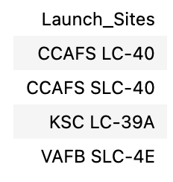
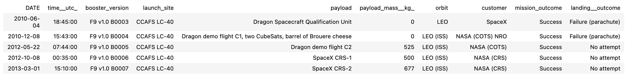
RESULTS
SQL (EDA with SQL)
The names of the unique launch sites in the space mission
5 records where launch sites begin with ‘CCA’

Slide 15
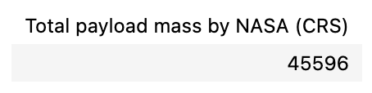
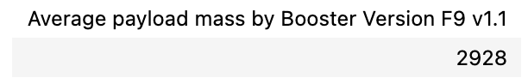
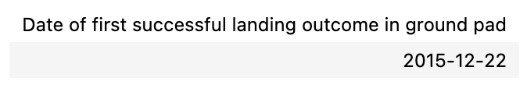
RESULTS
SQL (EDA with SQL)
The total payload mass carried by boosters launched by NASA (CRS)
The average payload mass carried by booster version F9 v1.1
The date when the first successful landing outcome in ground pad was achieved

Slide 16
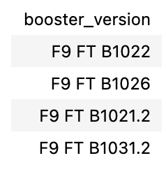
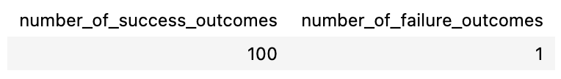
RESULTS
SQL (EDA with SQL)
The names of the boosters which have success in drone ship and have payload mass greater than 4000 but less than 6000
The total number of successful and failure mission outcomes

Slide 17
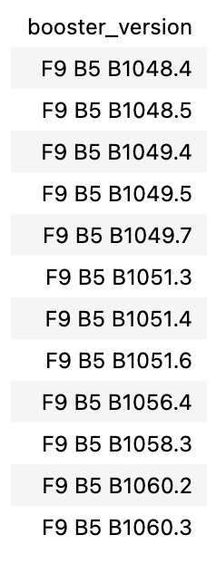
RESULTS
SQL (EDA with SQL)
The names of the booster versions which have carried the maximum payload mass

Slide 18
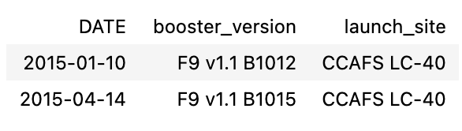
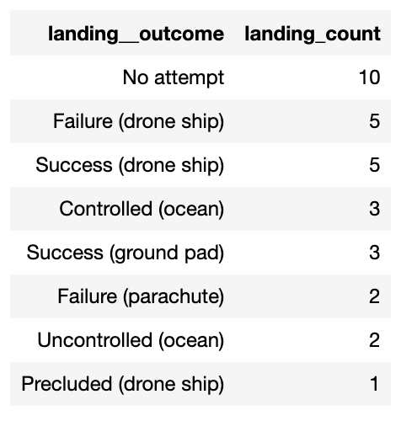
RESULTS
SQL (EDA with SQL)
The failed landing outcomes in drone ship, their booster versions, and launch site names for in year 2015
The count of landing outcomes between the date 2010-06-04 and 2017-03-20, in descending order

Slide 19
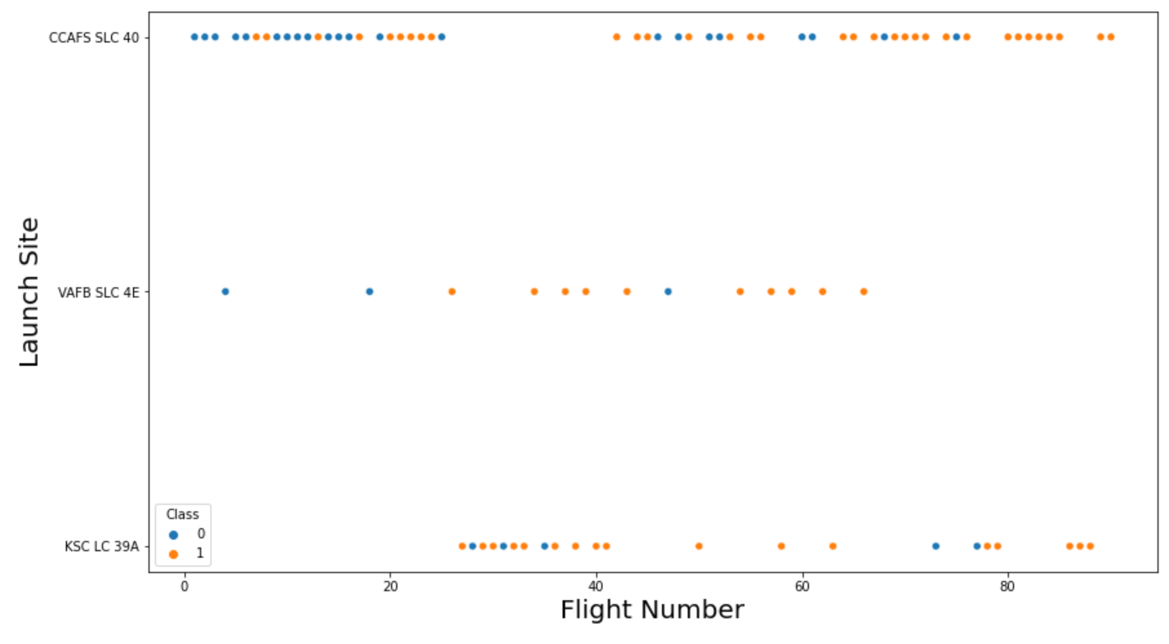
RESULTS
Matplotlib and Seaborn (EDA with Visualization)
The relationship between flight number and launch site

Slide 20
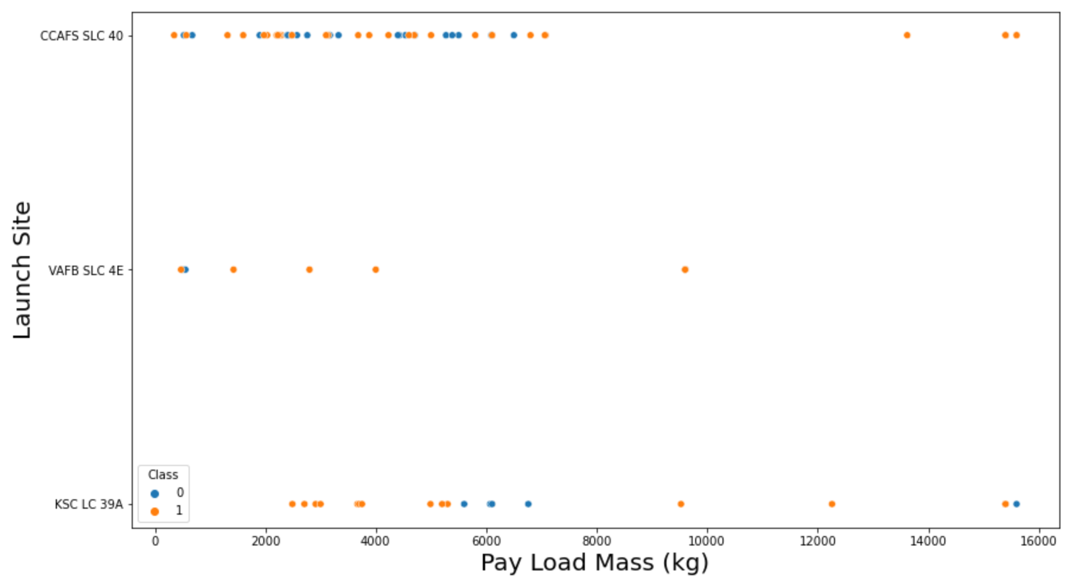
RESULTS
Matplotlib and Seaborn (EDA with Visualization)
The relationship between payload mass and launch site

Slide 21
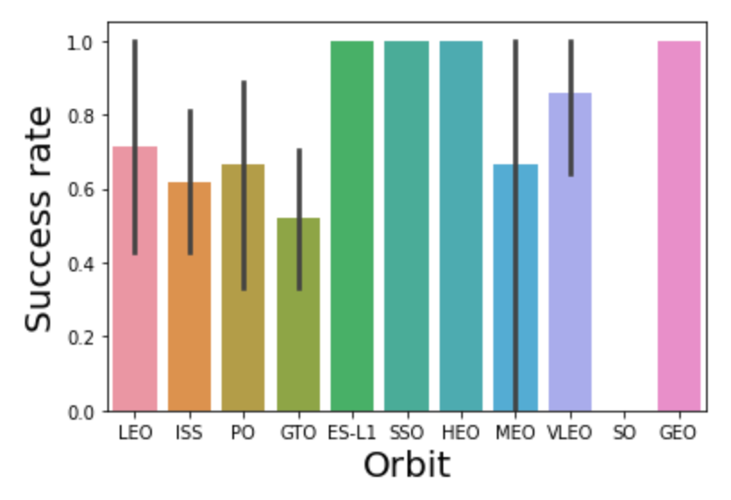
RESULTS
Matplotlib and Seaborn (EDA with Visualization)
The relationship between success rate and orbit type

Slide 22
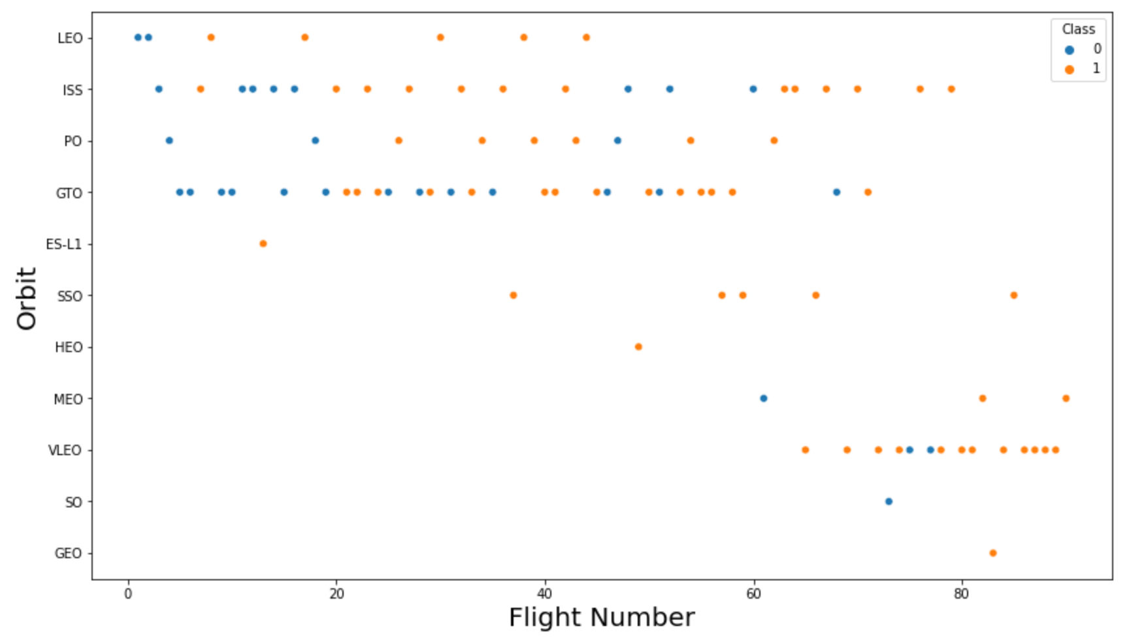
RESULTS
Matplotlib and Seaborn (EDA with Visualization)
The relationship between flight number and orbit type

Slide 23
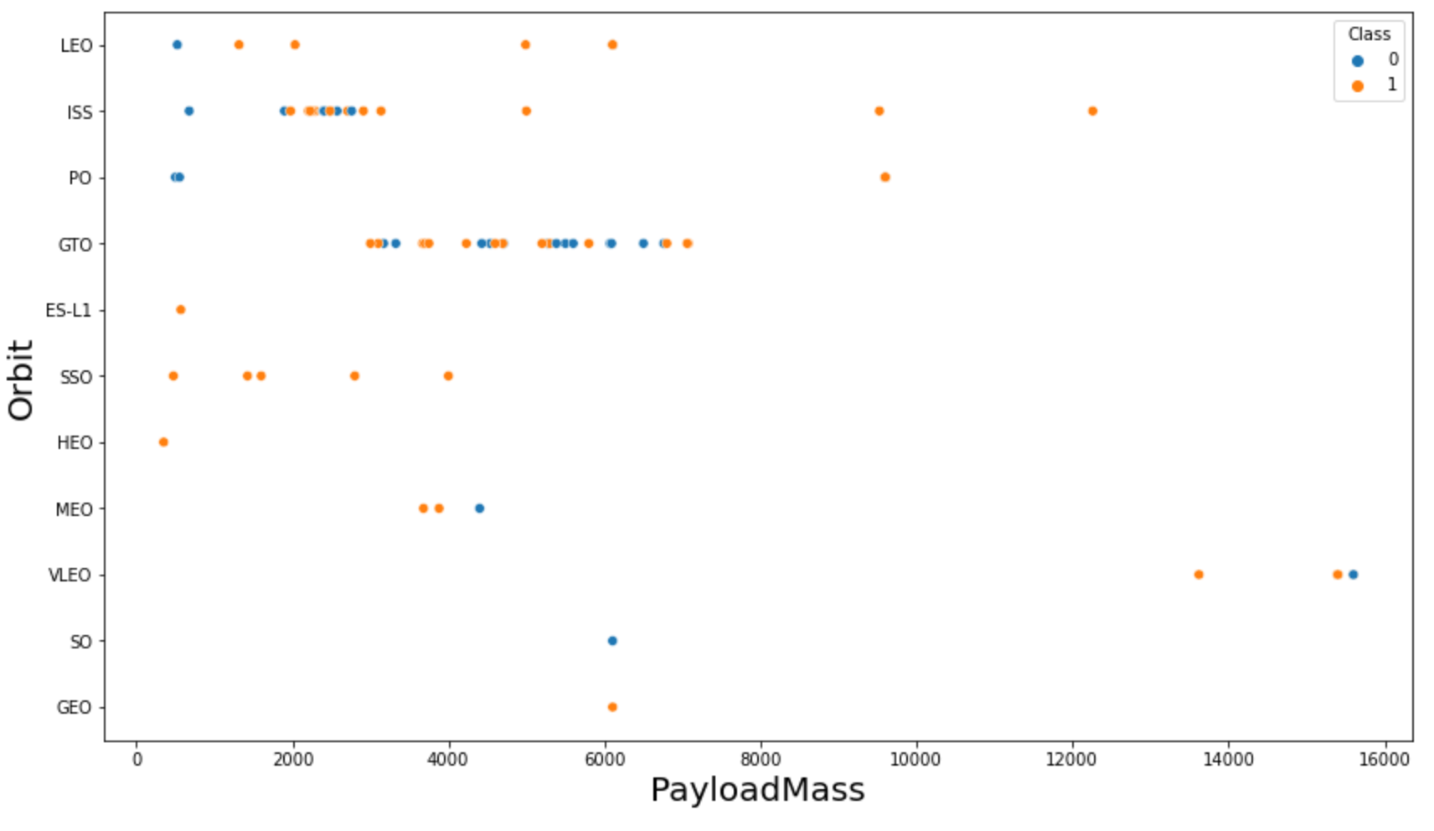
RESULTS
Matplotlib and Seaborn (EDA with Visualization)
The relationship between payload mass and orbit type

Slide 24
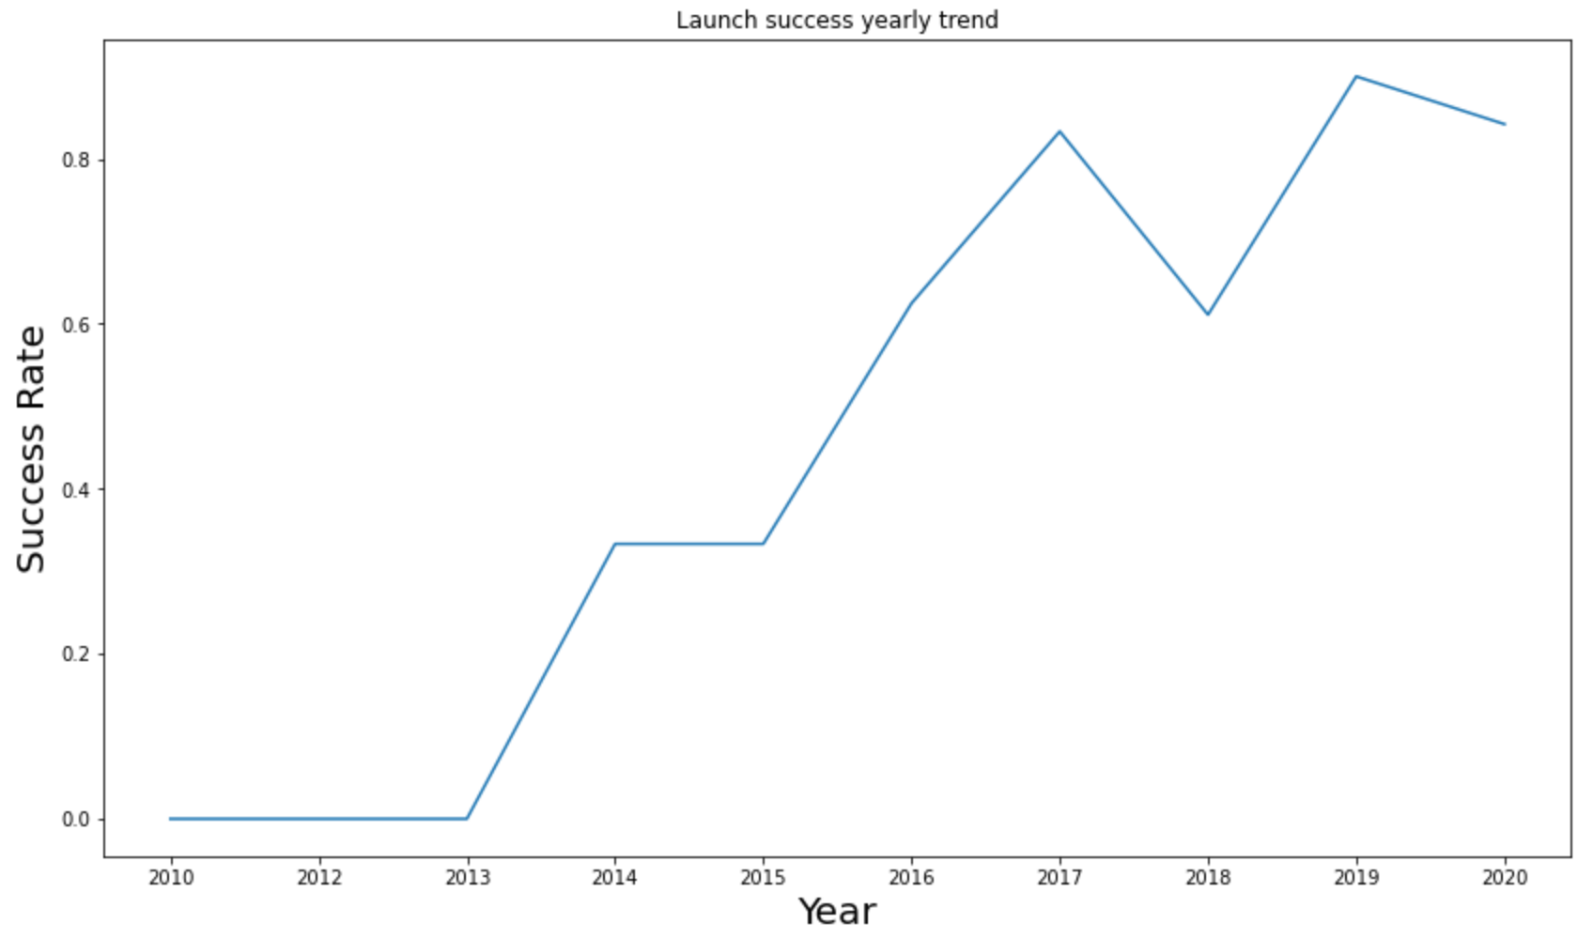
RESULTS
Matplotlib and Seaborn (EDA with Visualization)
The launch success yearly trend

Slide 25
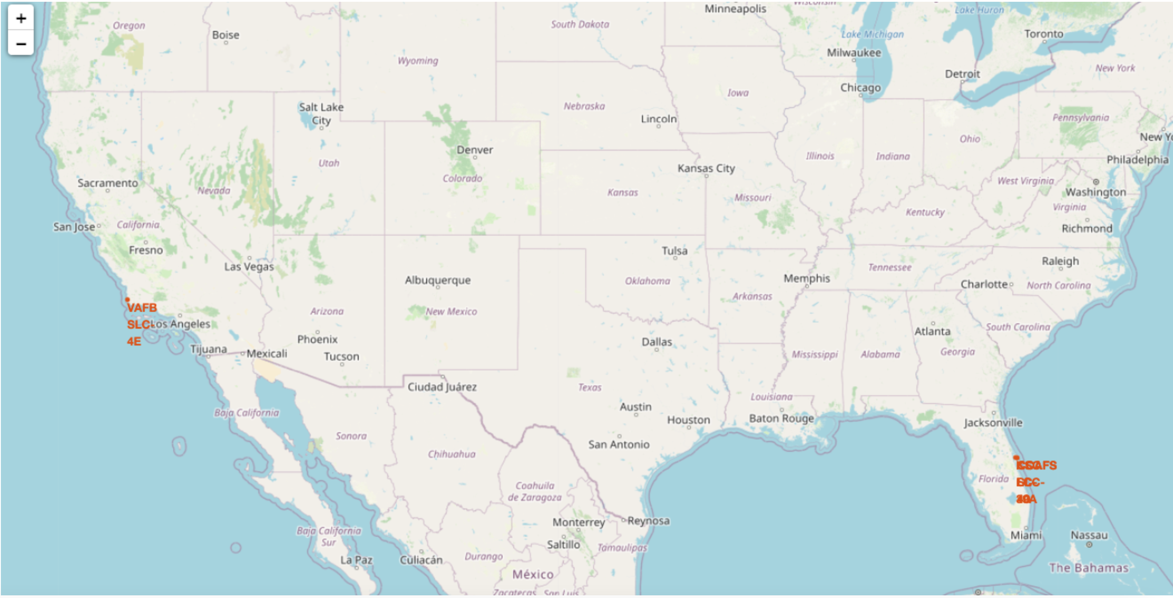
RESULTS
Folium
All launch sites on map

Slide 26
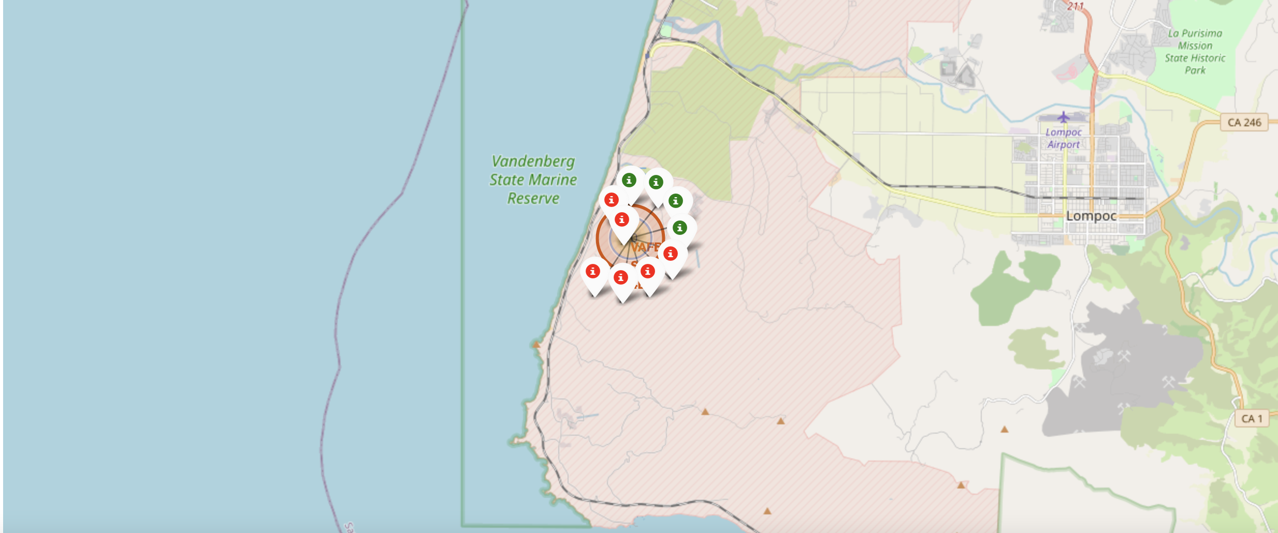
RESULTS
Folium
The succeeded launches and failed launches for each site on map
If we zoom in on one of the launch site, we can see green and red tags. Each green tag represents a successful launch while each red tag represents a failed launch

Slide 27
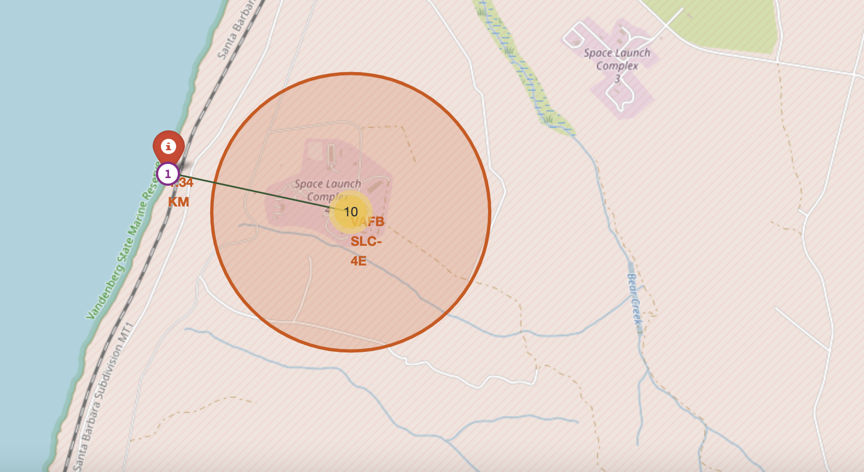
RESULTS
Folium
The distances between a launch site to its proximities such as the nearest city, railway, or highway
The picture below shows the distance between the VAFB SLC-4E launch site and the nearest coastline

Slide 28
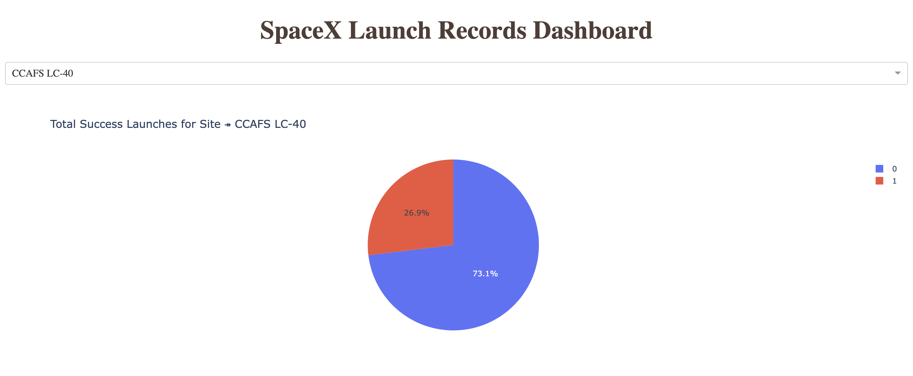
RESULTS
Dash
The picture below shows a pie chart when launch site CCAFS LC-40 is chosen.
0 represents failed launches while 1 represents successful launches. We can see that 73.1% of launches done at CCAFS LC-40 are failed launches.

Slide 29
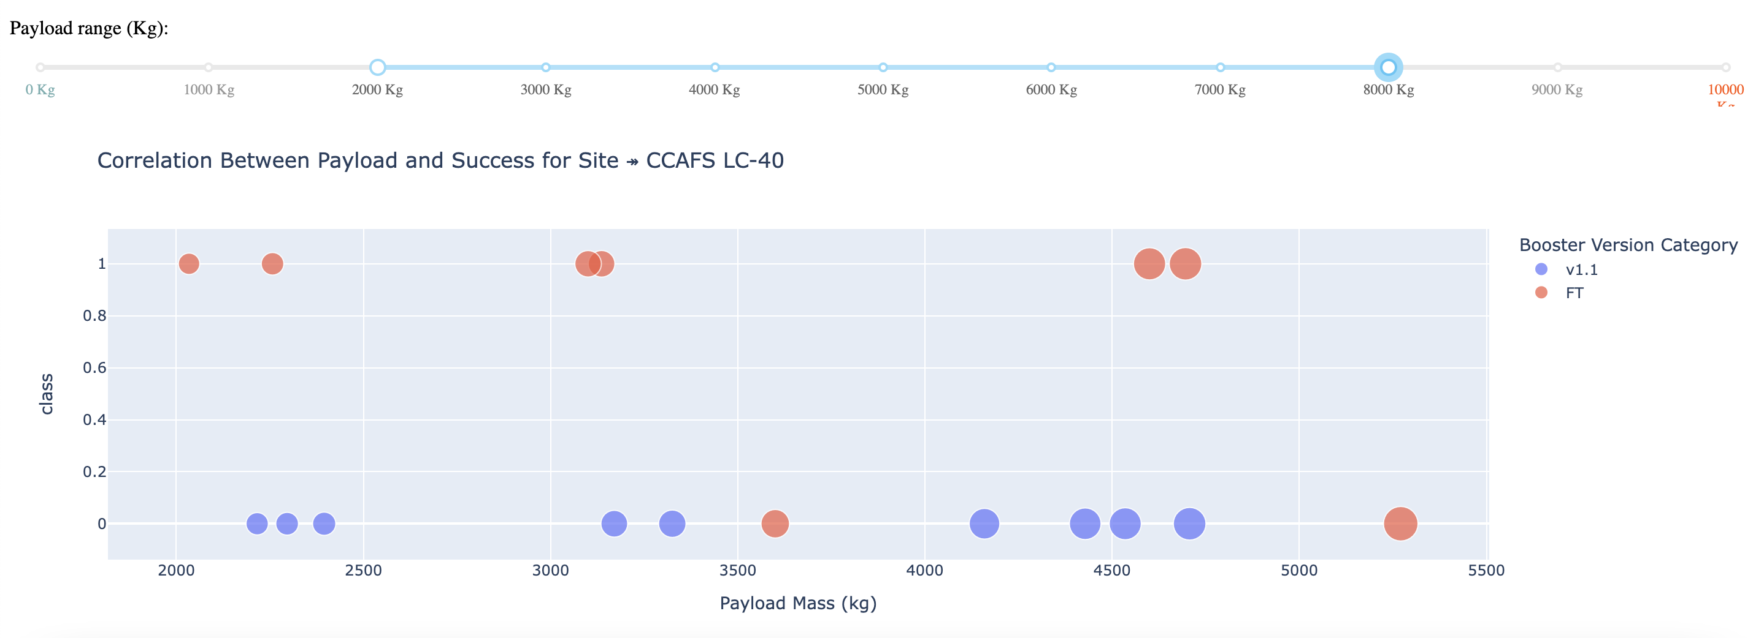
RESULTS
Dash
The picture below shows a scatterplot when the payload mass range is set to be from 2000kg to 8000kg.
Class 0 represents failed launches while class 1 represents successful launches.

Slide 30
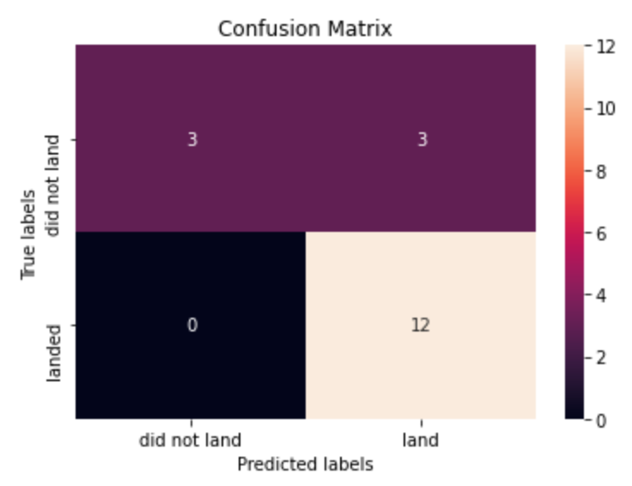
RESULTS
Predictive Analysis
Logistic regression
GridSearchCV best score: 0.8464285714285713
Accuracy score on test set: 0.8333333333333334
Confusion matrix:

Slide 31
RESULTS
Predictive Analysis
Support vector machine (SVM)
GridSearchCV best score: 0.8482142857142856
Accuracy score on test set: 0.8333333333333334
Confusion matrix:

Slide 32
RESULTS
Predictive Analysis
Decision tree
GridSearchCV best score: 0.8892857142857142
Accuracy score on test set: 0.8333333333333334
Confusion matrix:

Slide 33
RESULTS
Predictive Analysis
K nearest neighbors (KNN)
GridSearchCV best score: 0.8482142857142858
Accuracy score on test set: 0.8333333333333334
Confusion matrix:

Slide 34
RESULTS
Predictive Analysis
When comparing the results of the four models side by side, we observe that all achieved identical accuracy scores and confusion matrices on the test dataset. As a result, we rely on their GridSearchCV best scores to differentiate and rank their performance. Based on these scores, the models are ranked from highest to lowest as follows:
Decision Tree — Best score: 0.8893
K-Nearest Neighbors (KNN) — Best score: 0.8482
Support Vector Machine (SVM) — Best score: 0.8482
Logistic Regression — Best score: 0.8464
This ranking indicates that the decision tree model outperformed the others in hyperparameter-tuned validation, even though all models performed equally on the test set.

Slide 35
DISCUSSION
The data visualization phase revealed that certain features may be correlated with the mission outcome in different ways. For instance, missions carrying heavier payloads tend to have higher landing success rates when targeting orbits such as Polar, LEO, and ISS. In contrast, for missions to GTO, the data is more ambiguous, as both successful and unsuccessful landings occur with similar frequency.
These observations suggest that individual features can influence the final outcome of a mission. While it is challenging to determine the exact relationship between each feature and mission success, machine learning algorithms can be leveraged to uncover patterns in historical data. By doing so, we can build predictive models capable of estimating the likelihood of a successful landing based on specific launch conditions.

Slide 36
CONCLUSION
This project focuses on forecasting whether the first stage of a Falcon 9 rocket will successfully land, a key factor in estimating the total launch cost.
To achieve this, we analyze various characteristics of each launch—such as payload mass and orbit classification—that may influence the mission’s success.
By applying multiple machine learning techniques to historical launch data, we aim to uncover patterns that help predict future outcomes.
Among the four algorithms tested, the decision tree model demonstrated the highest accuracy and outperformed the others in predictive performance.

